Slide 1

Predicting Titanic Passenger Survival
CCAI312 (Pattern Recognition Project)

Slide 2
Introduction
The Titanic tragedy remains one of the most famous disasters in history.
Using machine learning, we aim to predict passenger survival based on demographic and socioeconomic attributes.
This project applies algorithms like XGBoost, KNN, and Decision Tree to uncover patterns influencing survival.

Slide 3



Problem Description
Classification Problem:
Predict survival outcomes for passengers.
Input:
Passenger attributes (e.g., age, class, gender).
Output:
Binary classification (Survived or Not Survived).

Slide 4

Dataset Description
Challenges
Features
Missing values.
Imbalanced survival rates.
Passenger details: Name, Sex, Age.
Ticket information: Pclass, Fare, Embarked.
Family connections: SibSp, Parch.
Target
Predict: Survived (0 = No, 1 = Yes).

Slide 5




Preprocessing Steps
Handling Missing Values
Encoding Categorical Variables
Feature Selection
Feature Scaling
Impute missing Age and Fare with medians.
Fill missing Embarked values with the mode.
Binary encoding for Sex.
One-hot encoding for Embarked.
Dropped irrelevant features: PassengerId, Name, Cabin.
Standardized numerical features: Age, Fare.

Slide 6

XGBoost
Why XGBoost?
The Chosen Model for Excellence.

Slide 7
XGBoost
Overview:
XGBoost, or Extreme Gradient Boosting, is a powerful algorithm that combines decision trees to improve accuracy. With features like regularization, tree pruning, and parallel computing, it excels in handling complex prediction tasks efficiently.

Slide 8



XGBoost Advantages
High efficiency in prediction.
Relies on error correction at each step.
Supports missing data and enables parallel processing.

Slide 9
XGBoost limitaions
High computational cost of XGBoost.
Sensitivity to hyperparameter tuning.
Dependency on the quality of textual features (e.g., text content)

Slide 10
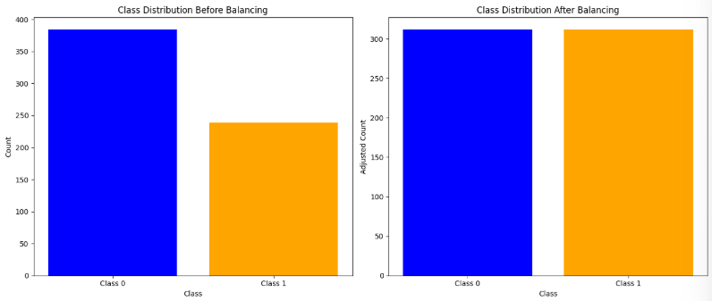
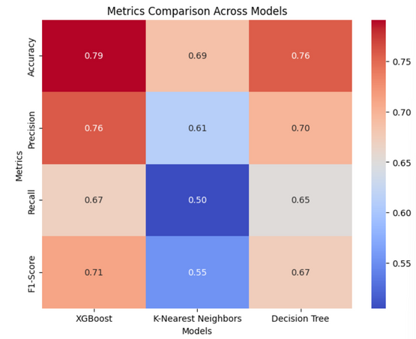
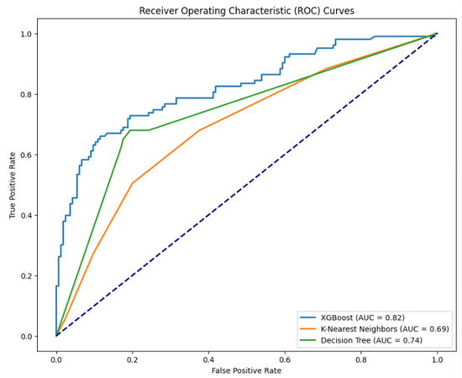
Exploratory Data Analysis
FIGURE 1: CLASS DISTRIBUTION BEFORE AND AFTER BALANCING
FIGURE2 :PERFORMANCE COMPARISON

Slide 11
Model Training and Hyperparameter Tuning
Initial Training:
Default XGBoost parameters used.
Achieved an accuracy of 79% on the train set.
Hyperparameter Tuning:
Used GridSearchCV to optimize key parameters: colsample_bytree, learning_ratem max_depthm min_child_weight, reg_alpha, reg_lambda, subsample
Tuned model achieved an accuracy of 81% after optimization.
Objective:
Maximize predictive performance while preventing overfitting.

Slide 12
Model Comparison with Benchmarks
Algorithms Tested:
XGBoost, K-Nearest Neighbors (KNN), Decision Tree.
Evaluation Metrics:
Accuracy, Precision, Recall, F1 Score.
Results:
XGBoost outperformed with the highest accuracy 81% and balanced precision/recall.
KNN and Decision Tree lagged due to overfitting and lack of boosting mechanisms.

Slide 13
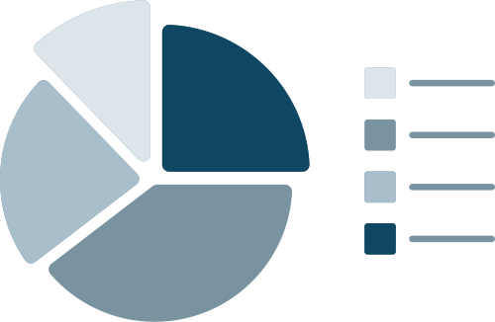
Results
Best Model:
Tuned XGBoost.
Performance Metrics:
Accuracy: 81%
Precision: 82%
Recall: 89%
F1 Score: 85%
Key Insights:
Model effectively predicts survival rate.
Consistent performance across training, validate and test datasets.

Slide 14
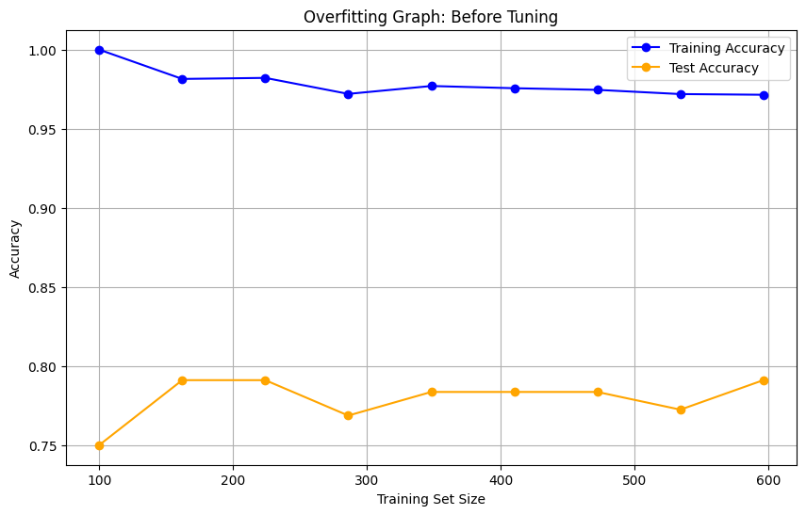
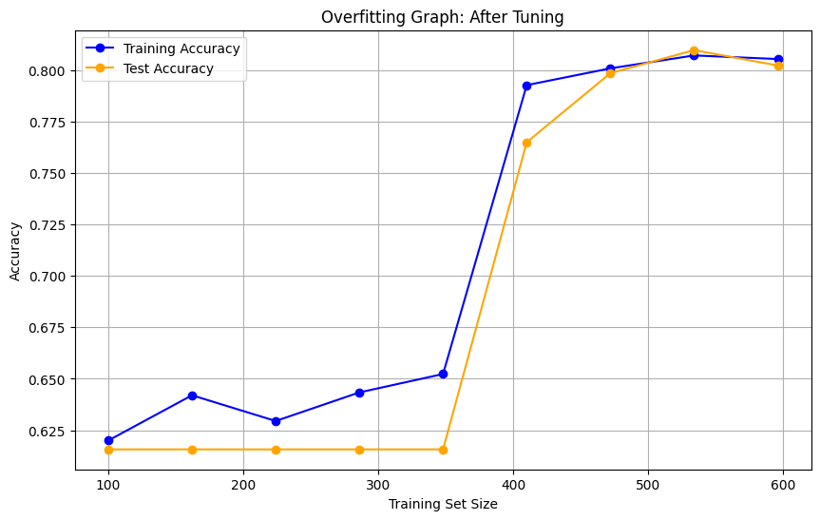
Results
Overfitting Plot for XGBoost Bafore And After Tuning

Slide 15
Future Improvements
Incorporate Ensemble Methods:
Combine models like Random Forest, Gradient Boosting, and XGBoost for better accuracy.
Address Missing Data:
Use advanced imputation techniques for missing Age and Cabin.
Explore Deep Learning:
Apply neural networks for non-linear relationships in the data.

Slide 16
Conclusion
Successfully predicted Titanic survival outcomes.
XGBoost proved to be the best-performing model, achieving 81% accuracy.
The project demonstrates the power of machine learning in improving customer support strategies.
Future enhancements can further refine predictions and scalability.
References
Dataset: Kaggle - Titanic: Machine Learning from Disaster
Methodology: XGBoost and Scikit-Learn Documentation for Machine Learning.

Slide 17
Thank you
Prepared by:
Futoon Abuzaid - 2211275
Selwan Halawani - 2210644
Albatool Al-Attas - 2210171
Instructor: Dr. Safaa Al-Safri
Semester: Fall 2024

